Slide 1
NYC 311’s: A Noisy Piece of Color
David Chang

Slide 2
311 Data Analysis

Slide 3
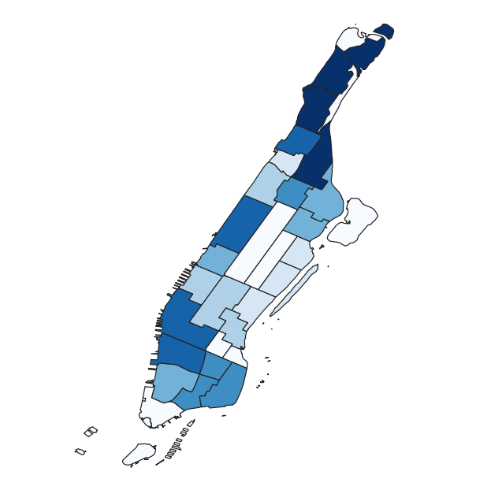

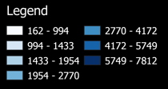

Data
West Side of the island has more 311 complaints than the east.
Upper West side has the highest concentration of 311 complaints
Conclusions
Expectations and observational bias?
Higher population?

Slide 4
Data Extrapolation: COVID testing data

Slide 5
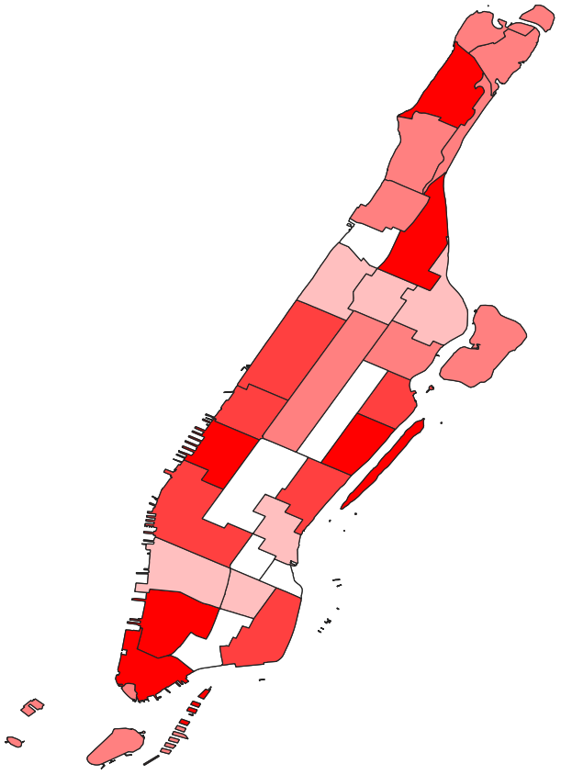
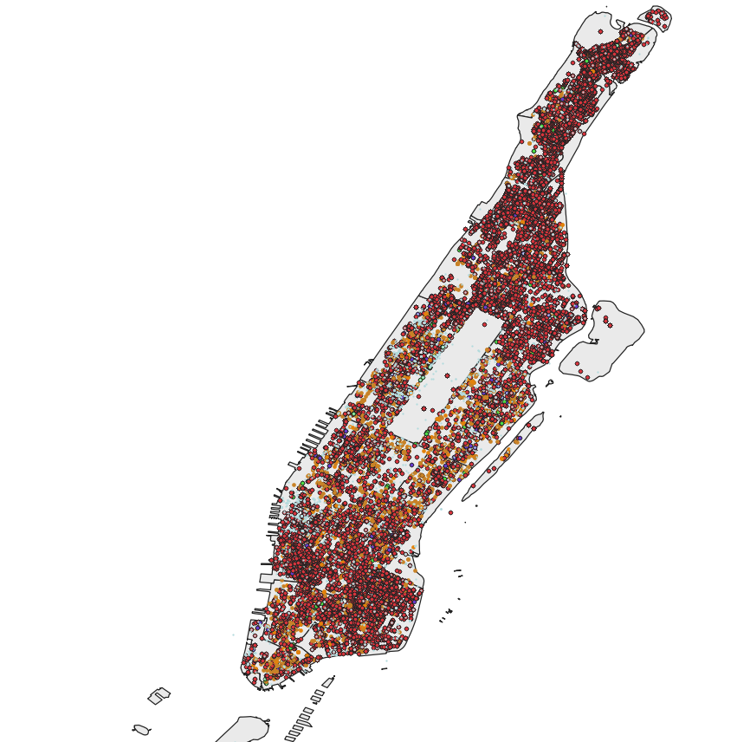
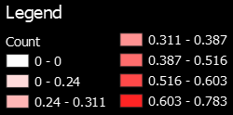
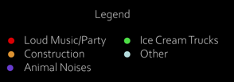

311 complaints by type (emphasis on Loud Parties)
City COVID PCR testing positivity (August 2021)

Slide 6
Analysis
Data
Conclusions
Certain areas of Manhattan have significantly increased positivity rate than their neighbors
Identify “sections” of the city that tend to have more positive COVID cases
Central Harlem
Bronx
Alternatively, Upper West side has relatively few noise complaints and COVID cases!
Wanted to look into look into see if it was possible to see a correlation between the loud parties and their locations with an increased prevalence in COVID rate
Areas where people “expect” noise vs areas where people “expect” relatively quietness
Parties = COVID?
Improvements?

